Slide 1
Group 09 Project Proposal:
Twitter Sentiment Analysis
Jingxin Zhou - jz4031
Yuyue Hua - yh3061
Xuechun Shen - xs1065
Jenna Eubank - jke261
Emma Marie Muhleman - emm10005

Slide 2
Table of Contents
CEO
Project Objectives
Workflow
Companies for analysis
Components
Sentiment visualization
Sentiment mapping by location
Text analysis and categorization
Data Source
Sentiment outputs
Location outputs
Questions

Slide 3
Twitter Sentiment Analysis
Compare the sentiment of Twitter conversation across competitive companies using python data visualization techniques and analysis.
max growth

Slide 4
Project Objectives
Visualize
Map
Text Analysis
Use python to create data visualizations comparing a variety of sentiment breakouts by:
Company
Over time
Pre/post-COVID time periods
Could potentially include more visualizations based on data
Transform location data for use in a heat map of the United States using sentiment scales as degrees.
Classify and extract meaningful information from unstructured text data.

Slide 5




Companies for Analysis
Haagen-Dazs
Ben & Jerry’s
Breyers
Talenti

Slide 6
Project Workflow
Visualize sentiment breakouts (by company, time, etc.)
Gather data from Talkwalker
Map sentiment by available locations
Step 1
Step 2
Step 3
Step 4
Step 5
Cleanse and prepare individual competitor datasets
Create text classification algorithm and visualize results

Slide 7
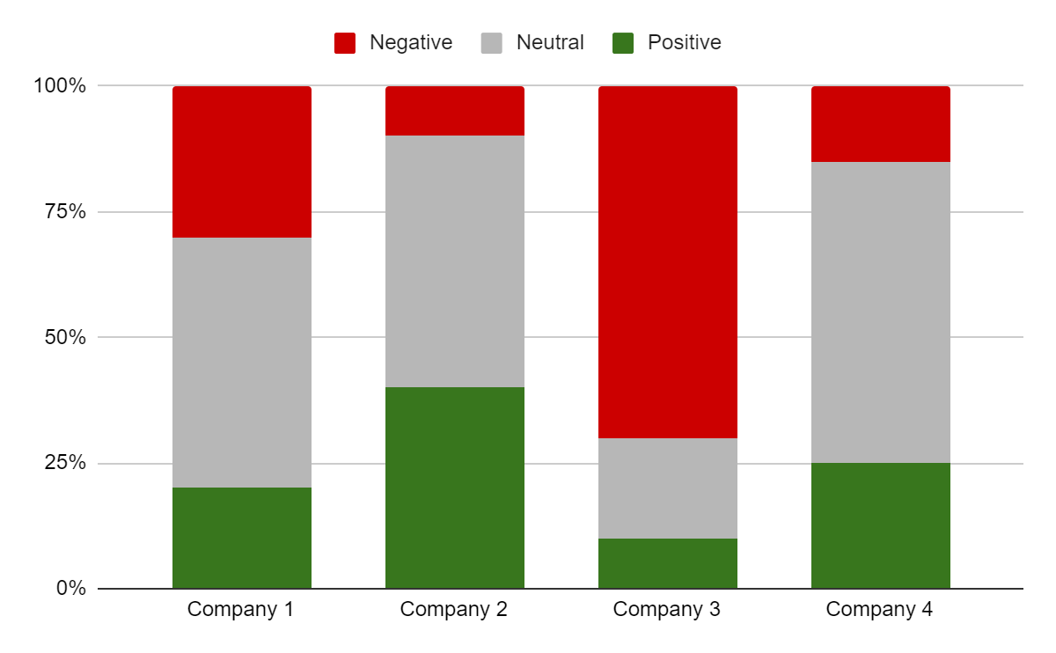
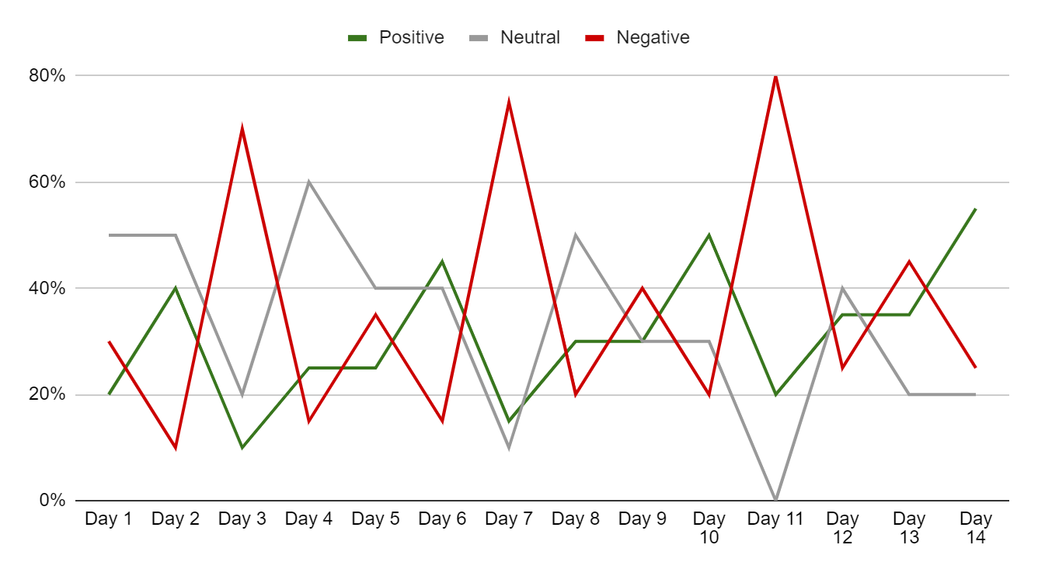
Project Components:
Sentiment Visualization
Use matplotlib graphs to view cuts of the data by different dimensions such as:
Company
Over time
Pre/post-Covid time periods
Sample Graphs

Slide 8
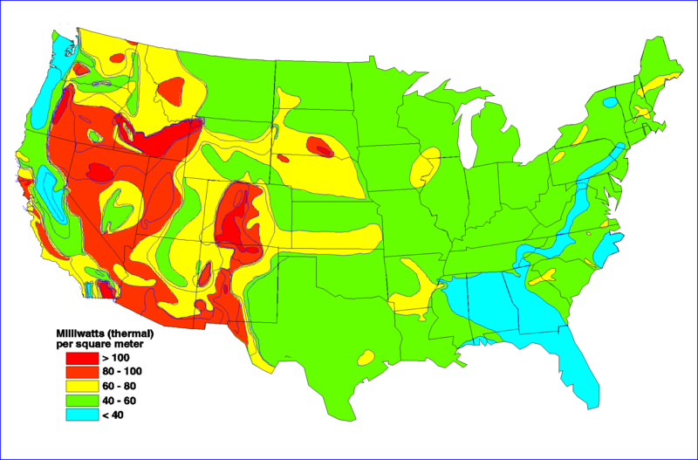
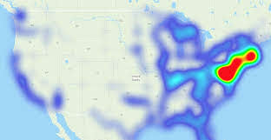
Project Components:
Sentiment Mapping by Location
Visualize and analyze differences in sentiment by location using python libraries (e.g. gmaps)
Sample Graphs

Slide 9
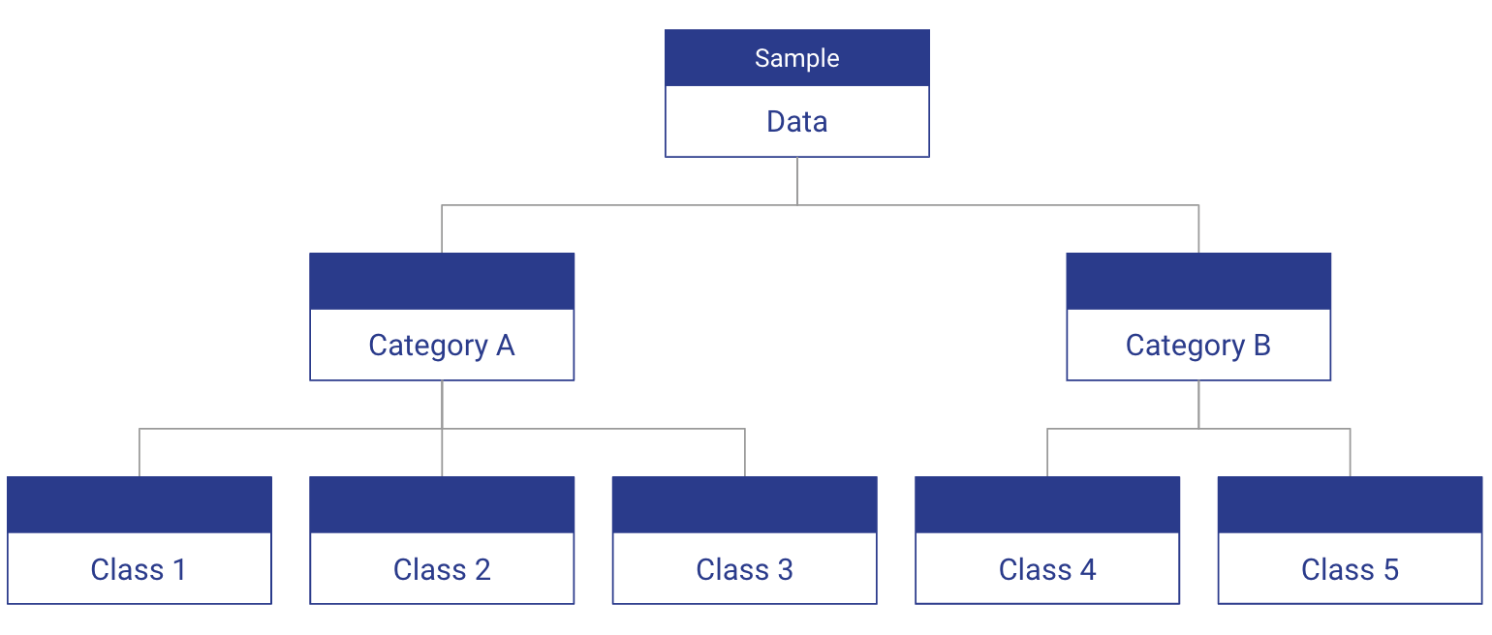
Project Components:
Text Analysis
Create an algorithm to categorize text data and extract insights about post sentiment by classification
Sample Graphs

Slide 10

Data Source
Talkwalker is a social media analytics tool & social media monitoring tool used worldwide.
Query based searching will allow our team to collect tweets relevant to our project.
CSV exports include full post text and a sentiment score which will be used for analysis.
Location data collected from Twitter will require preparation for location mapping.
Data will include Tweets from the US in English only.

Slide 11
Sentiment Outputs
Talkwalker uses deep learning models that simulate the cognitive functions of the human brain, the technology can understand complex language patterns and entire sentences, and even deal with basic forms of sarcasm and irony.
While developing the algorithms that are being used now, Talkwalker researched accuracy for the posts. Accuracy of AI-Powered Sentiment scales with the size of the training set from which the algorithm “learns”.
Talkwalker had to classified tens of millions of results to ensure the 90% accuracy rate the algorithm now delivers.
Source: Talkwalker

Slide 12
Location Outputs
In order to get the exact location of a result (latitude and longitude), the author needs to have location services enabled on their device.
If the location services are disabled on the device, then Talkwalker will analyze the language in order to assign a location. It can be collected from stated locations such as within the author bio.
Since location data can come in the format of city, state, or latitude and longitude it will need to be standardized into a single usable format.
Source: Talkwalker

Slide 13
Questions

